Slide 1
Embeddings

Slide 2
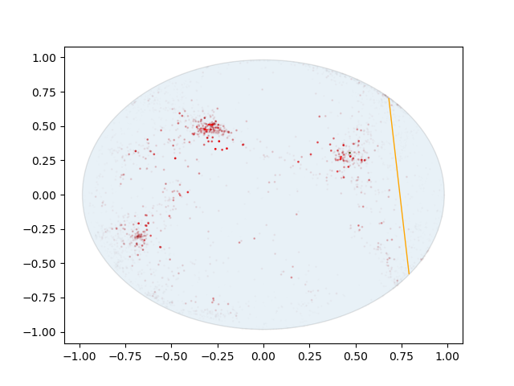
Airport
Red = Closeness Centrality
Solidness = Degree
Orange line- “Worst” positive edge

Slide 3
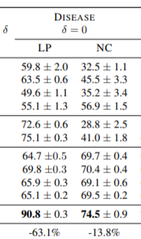
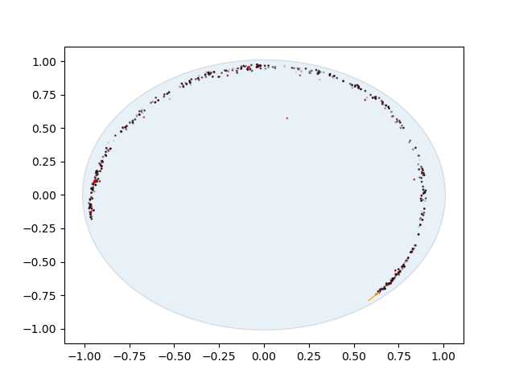
Disease
Color= Node type (no clear groupings)
Orange line- “Worst” positive edge
Our ROC is 92-93 on repeated runs
Other metric used is Average precision= (True positive/(True Positive+False positive}). We also improved on that metric

Slide 4
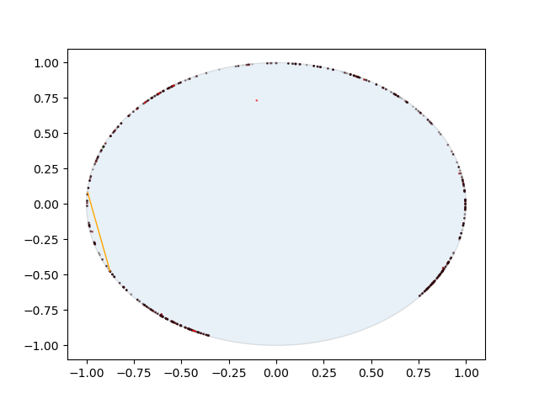
Disease
Changed loss function to maximize distance from neg pairs instead of direct probability preds.
Improves ROC to 94% but seems to decrease meaning in embeddings.

Slide 5
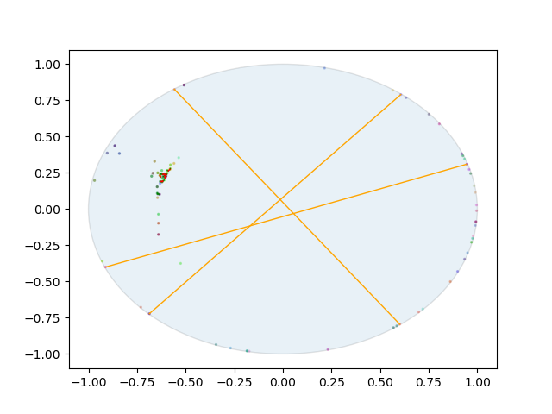
Brains!
Colors: x,y,z of brain region = RGB
Red line: Worst embedding of neg edge
Inputs for ROI- ciplv vals

Slide 6
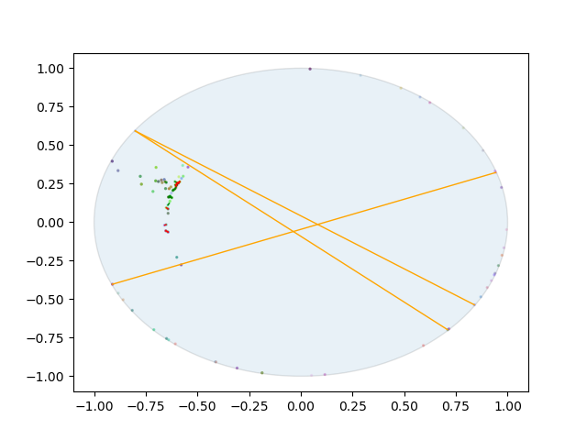
Brains!
Colors: x,y,z of brain region = RGB
Red line: Worst embedding of neg edge
Inputs for ROI- ciplv vals

Slide 7
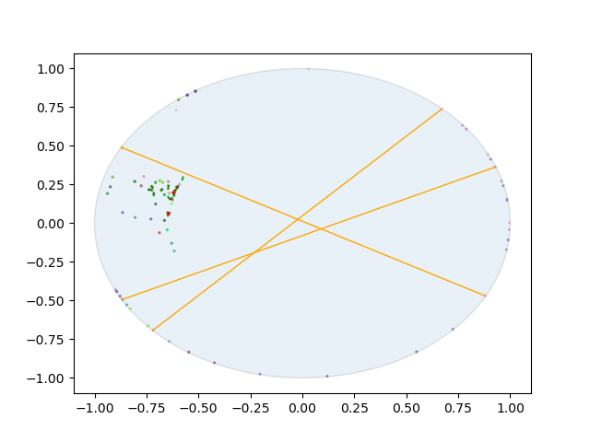
Brains!
Colors: x,y,z of brain region = RGB
Red line: Worst embedding of neg edge
Inputs for ROI- ciplv vals

Slide 8
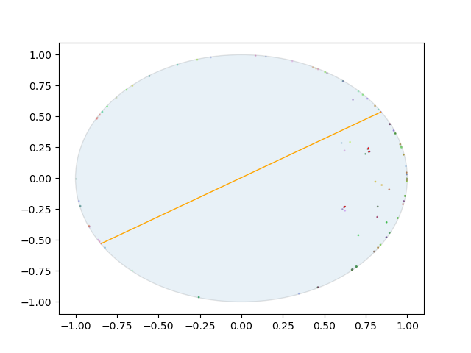
Brains!
Colors: x,y,z of brain region = RGB
Red line: Worst embedding of neg edge
Inputs for ROI- degree vals

Slide 9
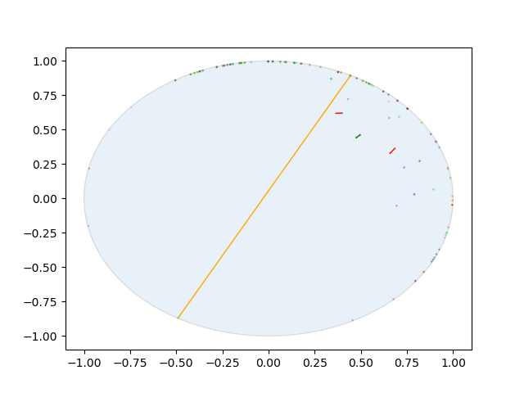
Brains!
Colors: x,y,z of brain region = RGB
Red line: Worst embedding of neg edge
Inputs for ROI- beta plv

Slide 10
Hyperbolicity
I plotted the histograms for these stats:
Mean Hyperbolicity
STD Hyperbolicity
% edges of possible (a 90x90 matrix can have ~4000 edges if fully connected, this % is out of that number)
Largest Connected Component (hyperbolicity can only be measured in Subgraphs that have where a path exists from every node to every node. As we eliminate edges, certain nodes or sets of nodes will become isolated and the largest connected component will shrink. This can skew the hyperbolicy results.
The x axis is the PLV threshold.

Slide 11
Hyperbolicity
I plotted the histograms for these stats:
Mean Hyperbolicity
STD Hyperbolicity
% edges of possible (a 90x90 matrix can have ~4000 edges if fully connected, this % is out of that number)
Largest Connected Component (hyperbolicity can only be measured in Subgraphs that have where a path exists from every node to every node. As we eliminate edges, certain nodes or sets of nodes will become isolated and the largest connected component will shrink. This can skew the hyperbolicy results.
The x axis is the PLV threshold.

Slide 12
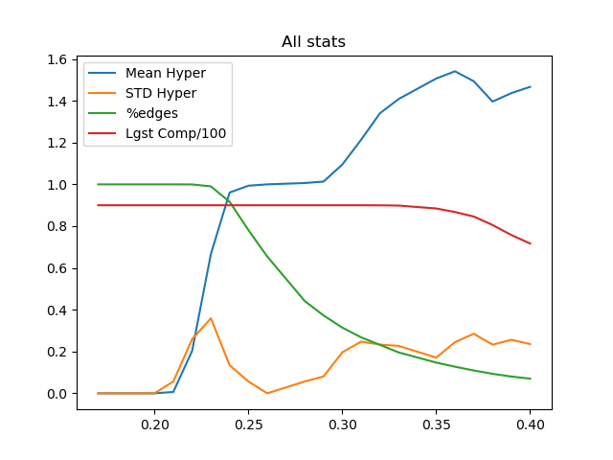
Hyperbolicity

Slide 13
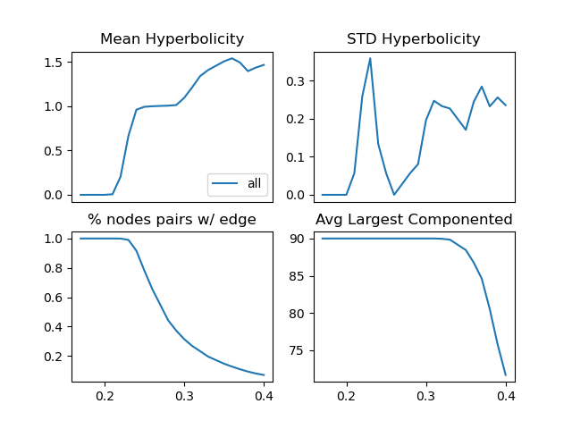
Hyperbolicity

Slide 14
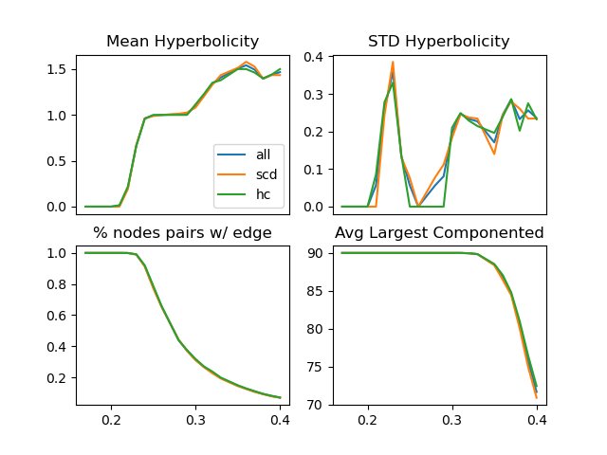
Hyperbolicity

